Slide 1
PROJECT : COFFEE SHOP SALES ANALYSIS USING SQL AND POWER BI
Objective : The Project aims to analyse the sales data for different coffee shops across different locations by analysing key metrics like sales volumes, growth in sales compared to previous time periods (e.g. month-over-month growth), identify patterns in sales data, such as seasonal fluctuations, and sales across different regions and categories for data driven decision making. The project also includes an interactive Power BI dashboards to transform raw data into interactive user friendly visuals to get a better understanding of key metrics influencing the sales.

Slide 2
KEY ATTRIBUTES OF THE DATA
The dataset contains 1,49,116 rows and 11 columns.
1) Transaction ID : Represents unique ID for each transaction (Primary key of the table).
2) Transaction date : Indicates the date of transaction.
Transaction time : Indicates time of transaction in terms of Hours and minutes.
Transaction QTY : Indicates the quantity of food products purchased on each transaction ID.
Store ID : Unique ID of the stores selling the products.
Store location : Location where the store is located.
Product ID : Unique ID for each product.
Unite Price : Indicates price for each unique product
Product Category : Category assigned to each unique Product.
Product type : Different types of Products including tea, coffee, chocolate
Product details : Indicates features of the product.

Slide 3
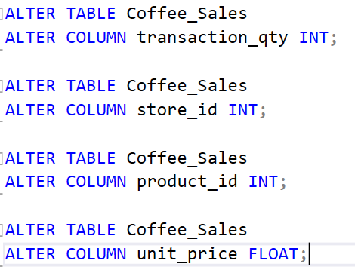
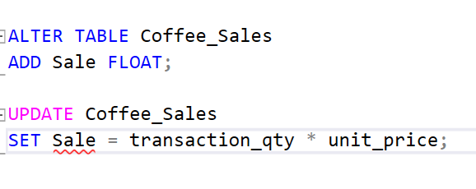
1. Data Processing : Columns such as transaction ID, Quantity, Store ID, product ID, and unit price contains numerical values but they were found to be in string datatype. The analysis required these columns to be transformed into number datatypes (either integer or float). The analysis also required creating a ‘Sale’ column by calculating the product of unit price and transaction quantity.
SQL QUERY

Slide 4
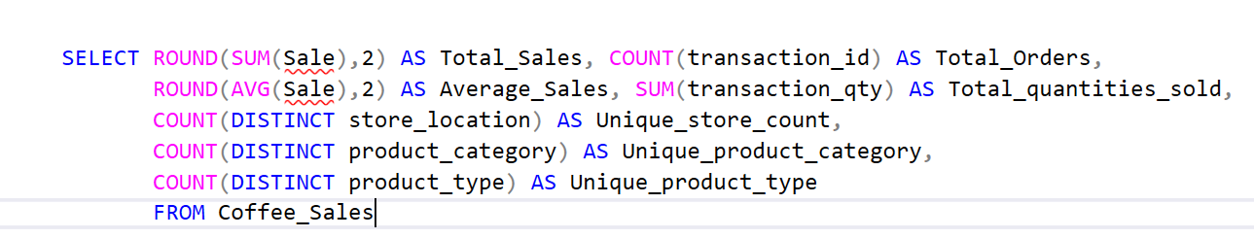
2. Find the total volume of sales, average sales, total number of transactions, unique number of product category, unique product type, and unique number of store type .
QUERY AND OUTPUT

Slide 5
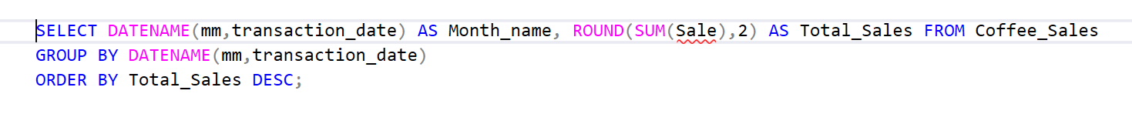
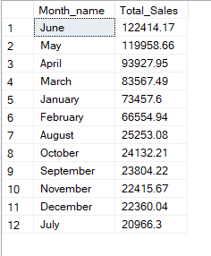
3. Find total sales for each month in descending order (month should be in name format and round off total sales to 2 decimal points).
QUERY AND OUTPUT

Slide 6
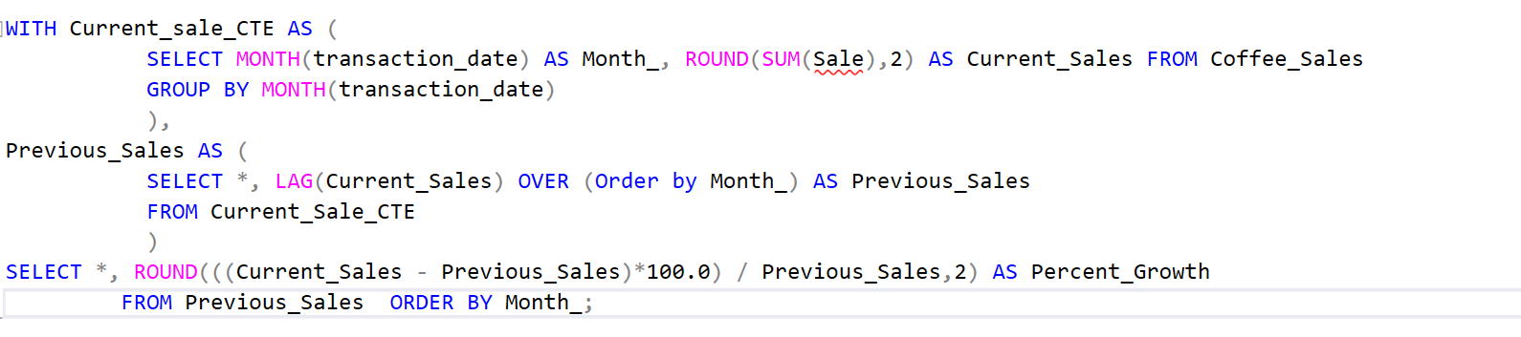
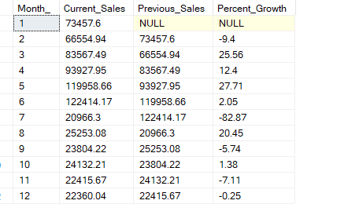
4. Calculate Month-over-month growth in sales based on sales of previous month.
QUERY AND OUTPUT

Slide 7
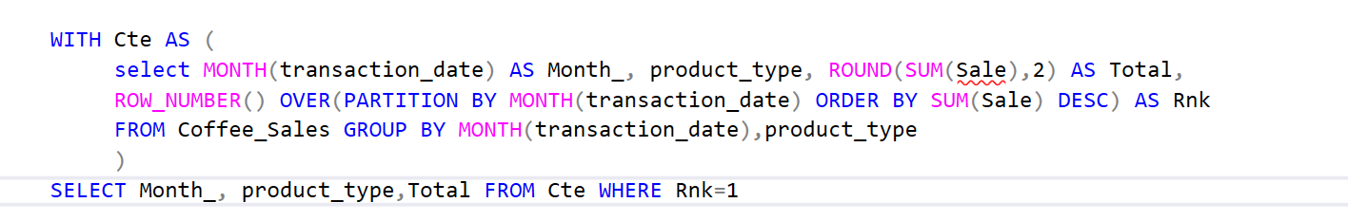
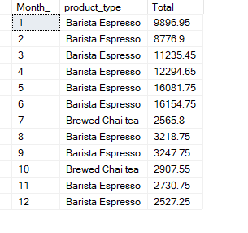
5. Find the highest selling product each month. Output the Month number, name of the highest selling product for that month, and its sales. (Round off total sales to 2 decimal points)
QUERY AND OUTPUT

Slide 8
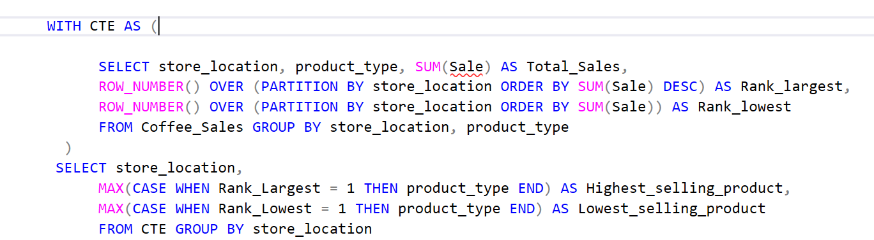
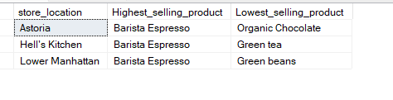
6. Find the highest and the lowest selling product for each store location.
QUERY AND OUTPUT

Slide 9
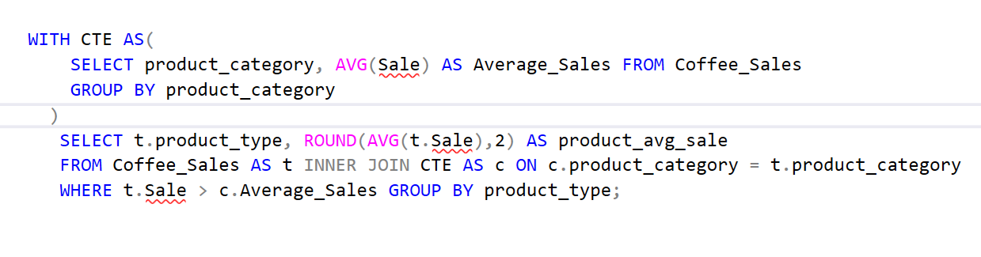
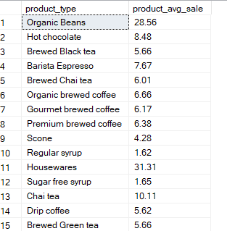
7. Find the product types which registered sales higher than the average sales of their respective category. Output the product name and their average sales.
QUERY AND OUTPUT

Slide 10
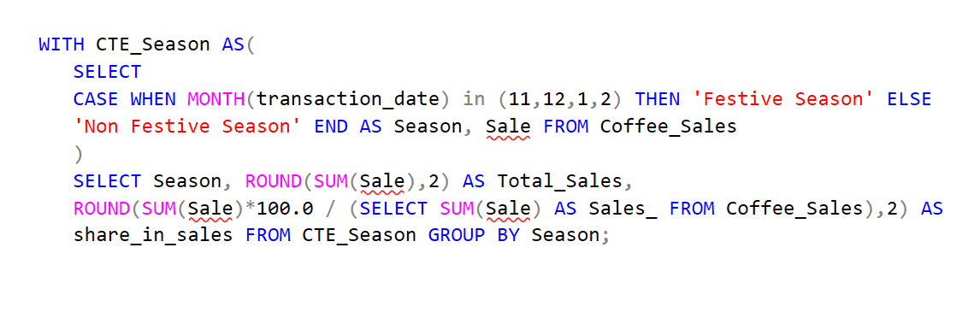
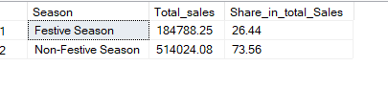
8. Compare sales for festive and non festive seasons and their percentage share in total sales. Consider the months from November to February as festive season.
QUERY AND OUTPUT

Slide 11
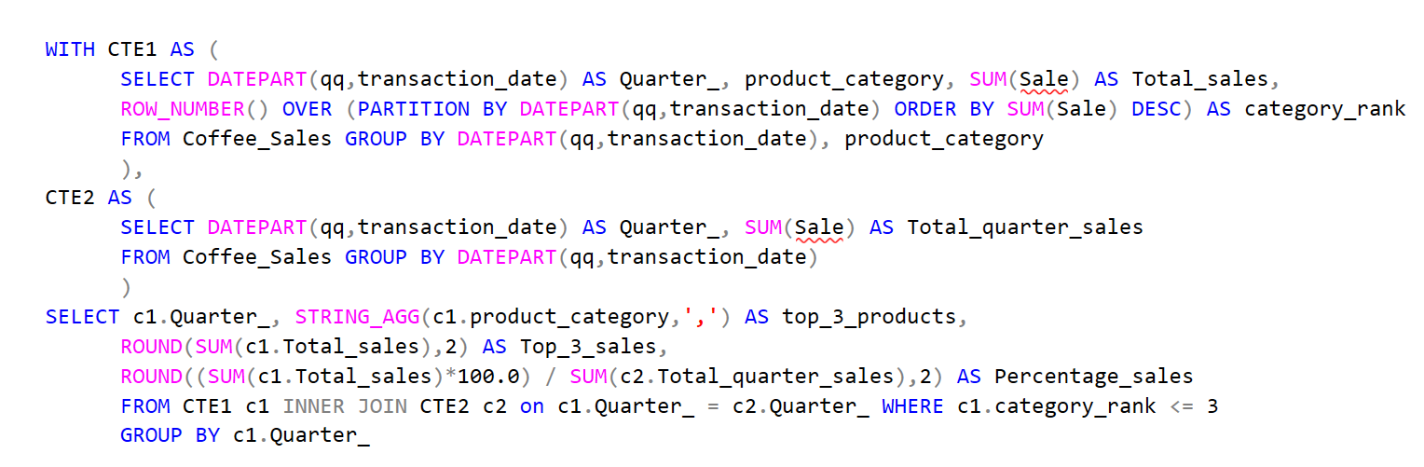
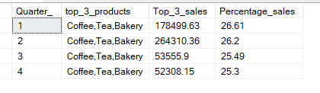
9. Identify top 3 selling products for each quarter. Output quarter, name of top 3 selling products, their aggregate sales for that quarter and their percentage share in total sales for that quarter.
QUERY AND OUTPUT

Slide 12
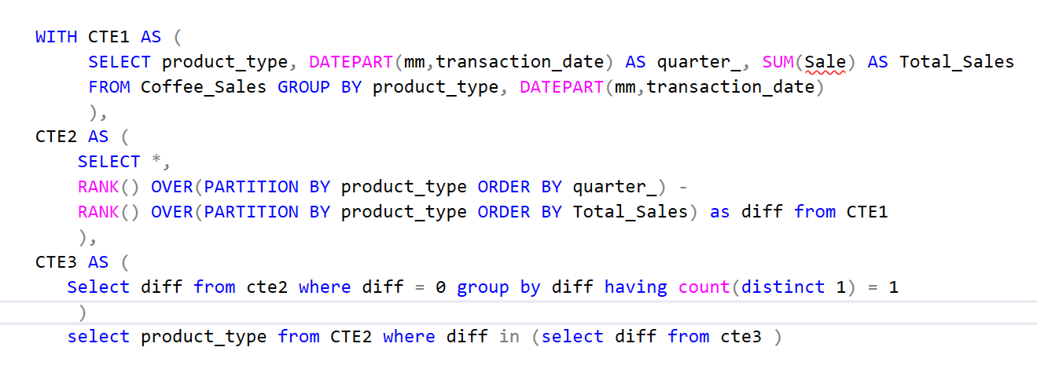

10. Find product types which registered growth in sales every month without any decline.
QUERY AND OUTPUT

Slide 13
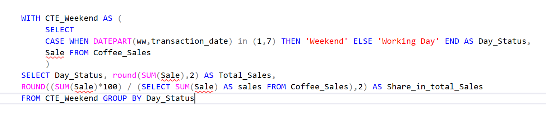

11. Compare Weekend sales with sales of working day and also calculate their percentage share in total sales
QUERY AND OUTPUT

Slide 14
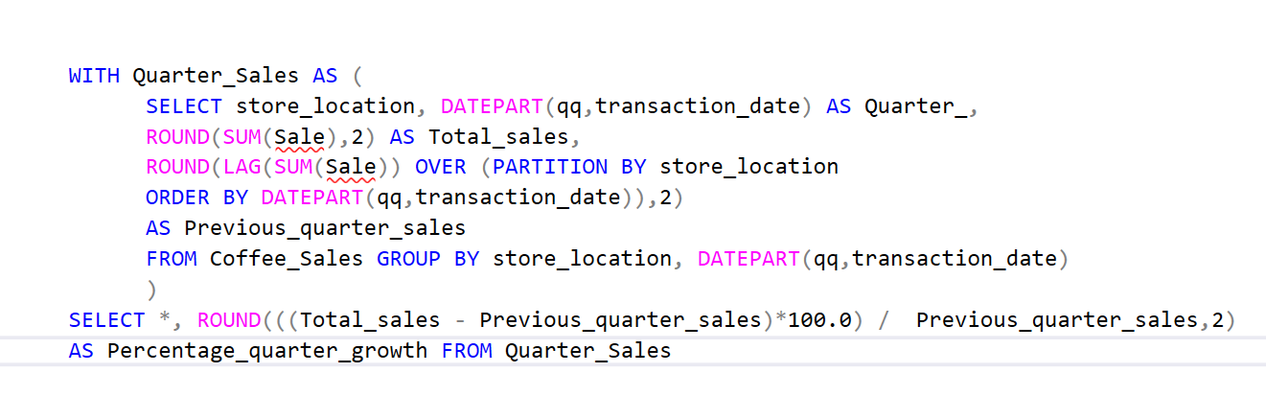
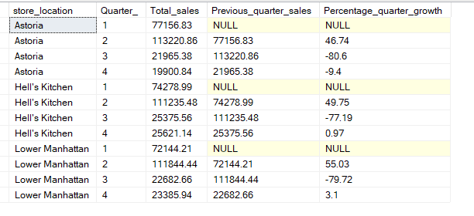
12. Calculate quarter-on-quarter growth in sales for each store location
QUERY AND OUTPUT

Slide 15
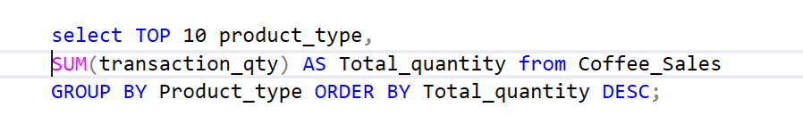
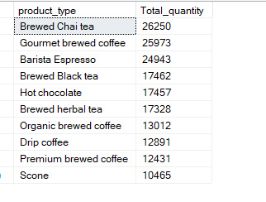
13. Identify the Top 10 purchased products (Products with highest selling quantity)
QUERY AND OUTPUT

Slide 16
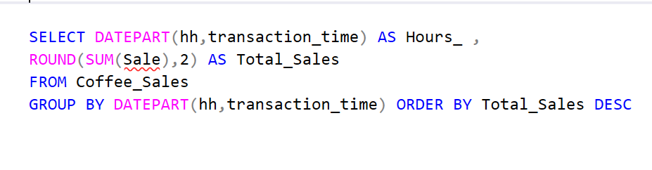
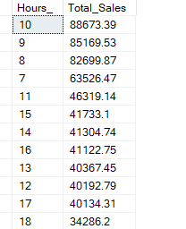
14. Calculate total sales based on each hour of the day to identify the time period registering the highest sales.
QUERY AND OUTPUT

Slide 17
